Slide 1

Battleship!

Slide 2
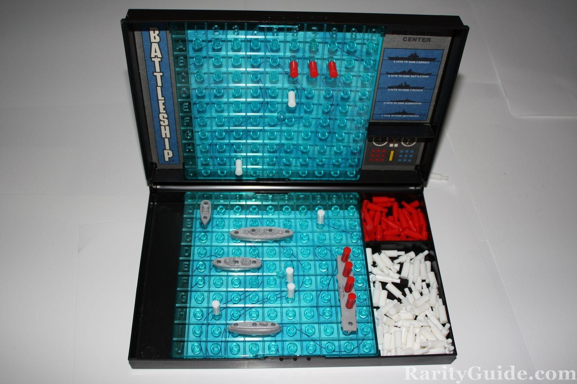
Classic game – pre smartphones and tablets, this provided hours of entertainment!
GAME SUMMARY:
Two players each have a “home” and “away” board.
They position their own ships on a board, then try to guess where the other player has positioned theirs.
Players take it in turns to call a grid reference and receive feedback - either “hit!” or “miss!
Can be played on a board, with a pencil and paper over the radio,... or with Ruby through a computer terminal???

Slide 3
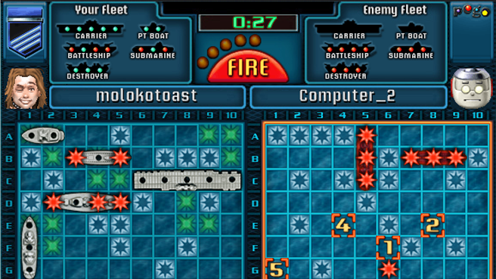
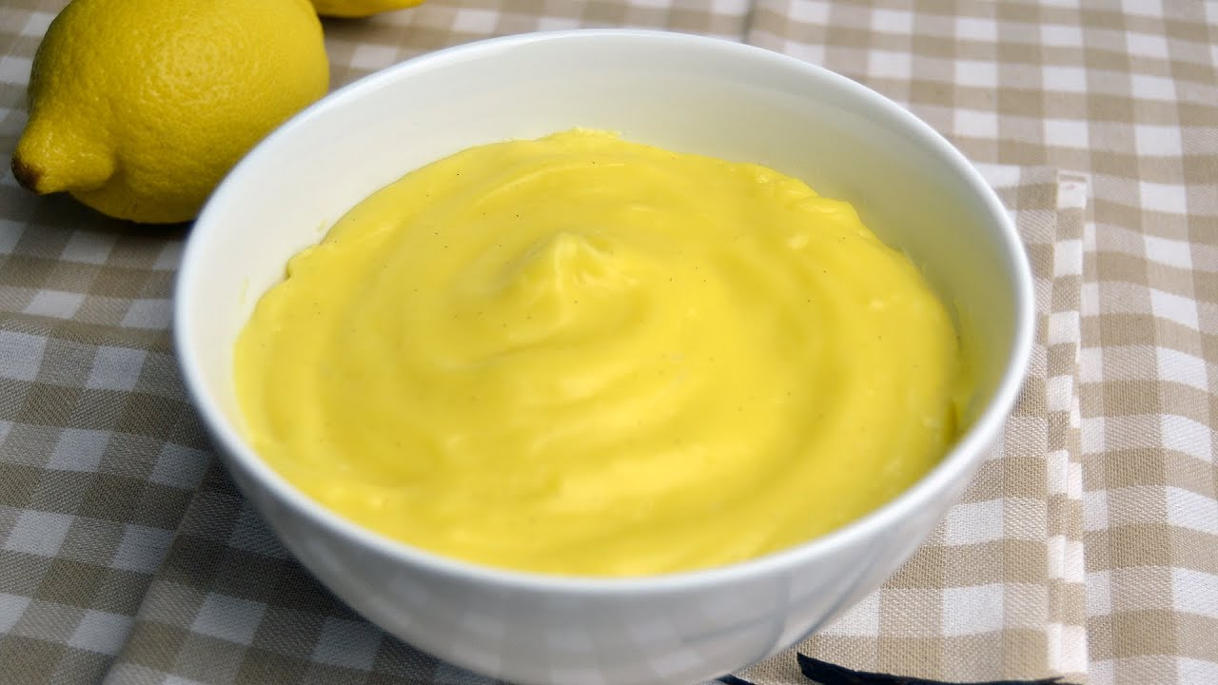
Summary of terminal features
You know I’m struggling when the key features include...
Greeting the user and requiring a password!
The user can choose where to place their ships on their board!
The computer can place its ships automatically!
It turns out the project is much more complicated than I thought.
My expectations went from this ..... to this :’(

Slide 4
So what is so hard?
To build a functioning game:
A visually appealing board needs to be set up, typically on a 10 x 10 grid.
The user will expect to give an alphanumeric grid reference to place an item on the board or shoot at it. And giving the variables alphanumeric names makes the logic much harder further on...
The ships need to be i) placed within the confines of the board ii) and not overlap with one another.
The computer needs to automatically generate the positions of its own fleet for the user to shoot at.
At least three variations need to be created and simultaneously maintained:
            One to show the user fleet and what the computer has hit;
            One to show the blank target (i.e. the grid showing the player’s hits and misses).
            One to show the position of enemy ships (the user would not see this, but it needs to exist and be linked to the second board).
The computer needs to be taught how to shoot straight (by generating a random grid reference), and ideally to shoot well (i.e. target squares around a hit, and predict that two hits in a row means there is a ship in that line; to know if an empty space is large enough for a ship to fit in).

Slide 5
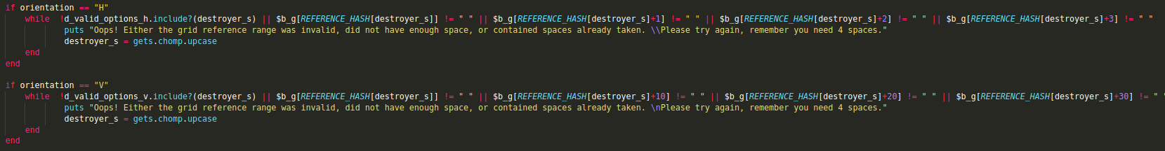
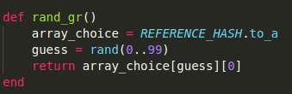
Challenge: Building a visually appealing board, that was easy to reference
Solution: A long string of special characters was used to build the board, with values interpolated in to the grid squares. Using a hash to map grid squares A1:J10 to the numbered variables on the board (1 to 100).
Challenge: Placing the ships on the board, and not allowing them to be placed outside the grid.
Solution: Creating an array which held a whitelist customised to the ship size and the orientation selected by the user in order to validate the available starting grid spaces.
Challenge: To avoid the ships overlapping. To do this based on an alphanumeric GR.
Solution: The default value for each square was a blank space. Therefore any squares that were not a blank space were unavailable. Depending on ship size and orientation, the following squares immediately to the right or underneath were also tested.
Challenge: Computer-generating a random alphanumeric value.
Solution: Creating an array from the hash; using the random number generator to pull out one of the keys. Then feeding the result through a validation loop.
Challenges overcome...

Slide 6
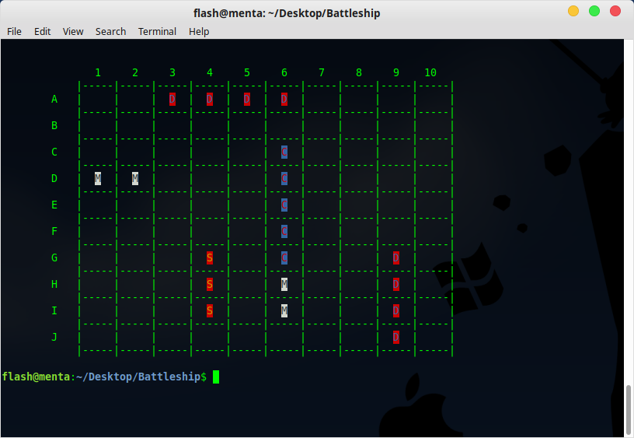
What did my end result look like?
.

Slide 7
Major learning points:
Things take longer than you think – don’t bite off more than you can chew.
Think ahead when planning (dependencies etc), and about the consequences of the design. Then revisit this after completing each block of code to see if anything has changed or if you have you thought of anything new.
Code is not always pretty. Sometimes it has to be ugly to work.
You can achieve a lot with the most basic building blocks (if/or statements, loops, arrays, and hashes etc). Sometimes looking for more “efficient” ways of doing things is actually counter productive.
Be prepared for the need to adjust your expectations!
Testing is not always easy – there was a practically infinite set of possibilities just to place ships on the board. With random numbers having been fed through (faulty) validation loops, recreating the error was almost never possible. Noticing patterns and hypothesising more important than reading the code.
Plaigerising answers from the internet is not always possible.

